Slide 1
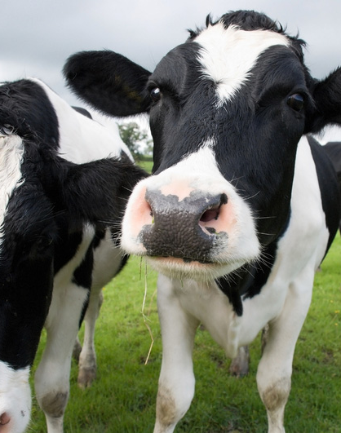

DAIRY CATTLE

Slide 2
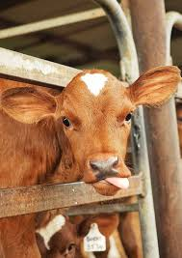
DAIRY CATTLE INDUSTRY
The dairy industry makes an important contribution to the Australian economy.
In 2017–18, it accounted for around 7% ($4.4 billion) of the gross value of agricultural production (Australian Bureau of Statistics 2019) and around 7% ($3.5 billion) of agricultural export income.
Australia is a small producer of milk but is the world’s third largest dairy exporter as 50% of production is exported.
The Australian dairy industry is Australia’s third largest rural industry, ranking behind wheat and beef.
Australia produces a range of dairy products including milk, milk powder, yoghurt, butter and cheese
The Australian dairy industry is concentrated in the south-east of Australia, Victoria is the largest production state, however other states have significant dairy industries
The dairy industry is heavily reliant upon water availability; the industry is currently facing uncertainty over water policy and drought conditions.

Slide 3
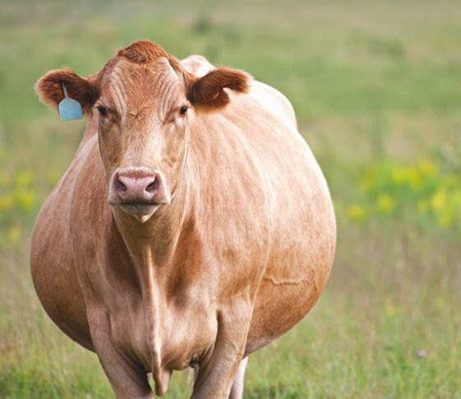
ORIGIN OF THE COW
Around 10,500 years ago, cattle were domesticated from as few as 80 ancestors in central Anatolia, the Levant and Western Iran.
Cattle, or cows (female) and bulls (male), are the most common type of large domesticated hoofed mammal.
They are a prominent modern member of the subfamily Bovinae.
Are the most widespread species of the genus Bos, and are most commonly classified collectively as Bos Taurus.
Pregnancy length does vary by breed and by sex of the calf.
Gestation length ranges from 279 to 287 days. For most breeds, 283 days would be common.
Cows carrying bull (boy) calves tend to have a slightly longer gestation compared to cows carrying heifer (girl) calves.

Slide 4
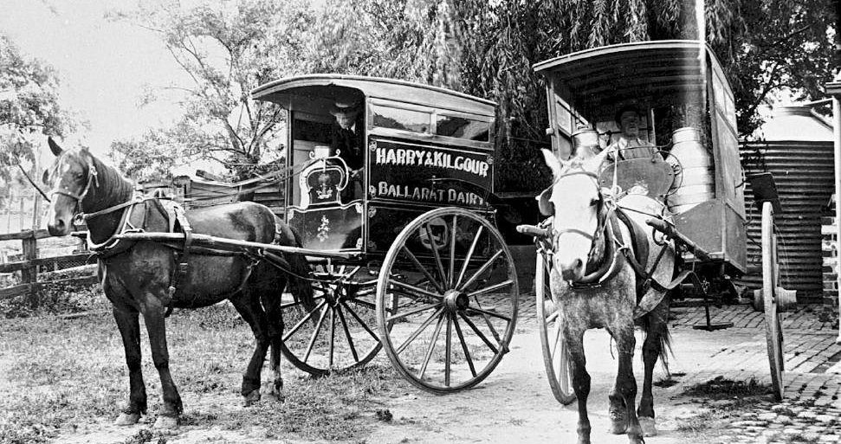
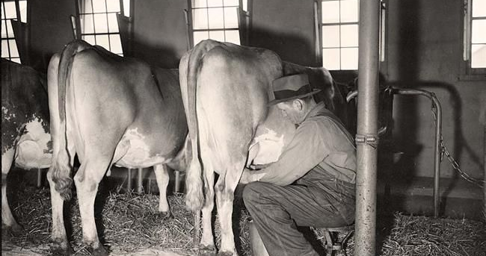
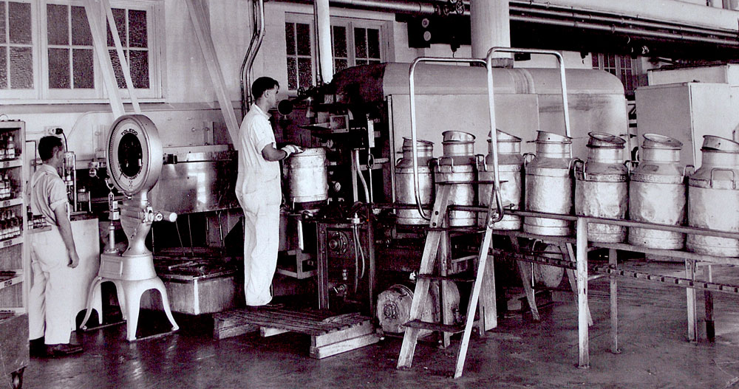
HISTORY OF AUSTRALIAN DAIRY INDUSTRY
The first dairy cows arrived in Australia with the first fleet in 1788.
The few cattle that first reached Australia were confronted with poor feed and grazing conditions; within months they had escaped.
The establishment of the colony’s dairy industry was postponed due to the overriding need for meat and the lack of refrigeration. This meant that the Australian industry where restricted to only supplying the domestic market.
Most dairies were in areas close to consumers, close to cities and towns. As refrigeration became more advanced (end of the 1800’s), the industry was able to become more commercialised. As a result, farmers were able to increase their efficiencies and profitability.
Cooperatives or Co-ops such as NORCO were established to transport, process and market the milk of farmers.

Slide 5
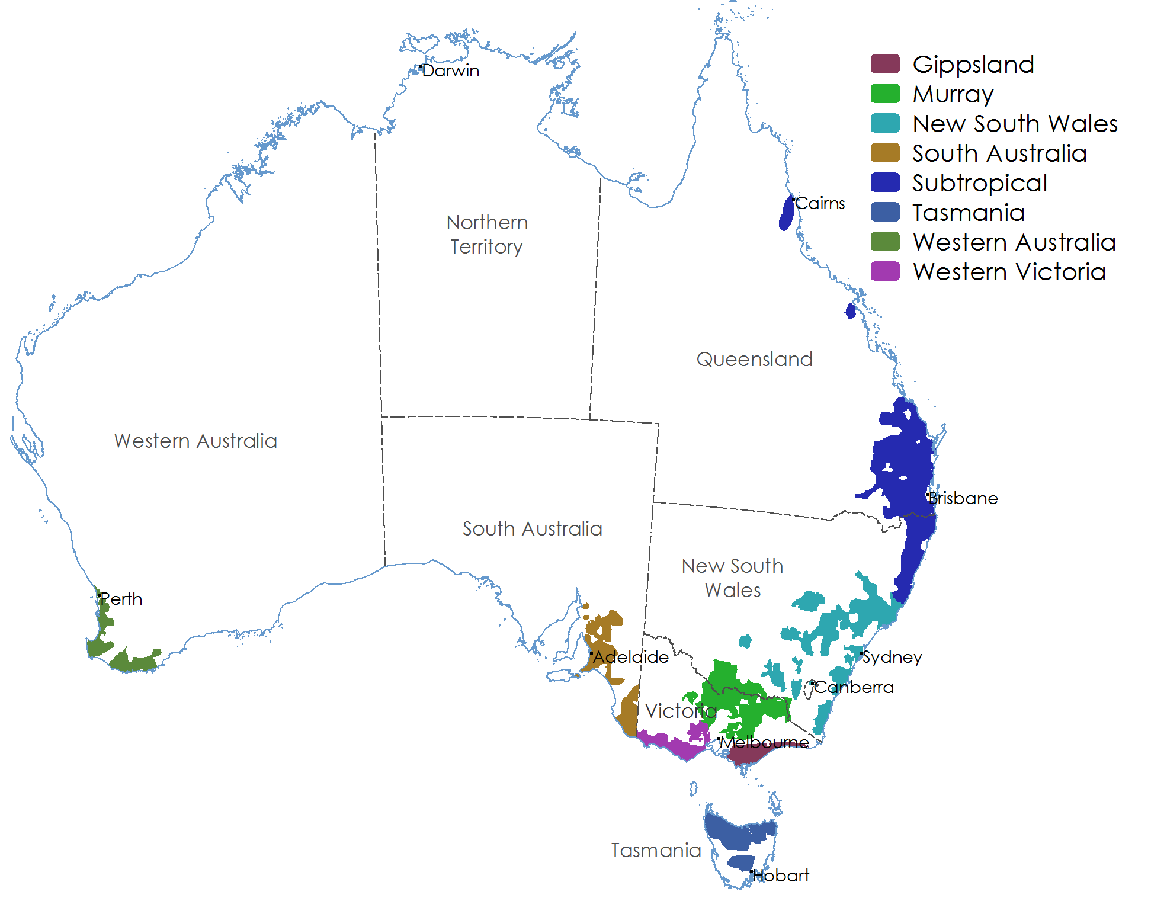
DAIRY CATTLE REGIONS
There are dairy farms located in all states in Australia and most of milk production takes place in the south-east corner of the country.
South-east Australia’s climate and natural resources are generally favourable to dairying and allow the industry to be predominantly pasture based.
In a year of ‘normal’ seasonal conditions, approximately 60%–65% of cattle feed requirements comes from grazing. This results in cost efficient, high-quality milk production.
Most farms are in coastal areas where pasture growth is generally reliant on rainfall.
There are several inland dairying areas reliant on irrigation schemes, most notably in northern Victoria and the New South Wales Riverina.

Slide 6
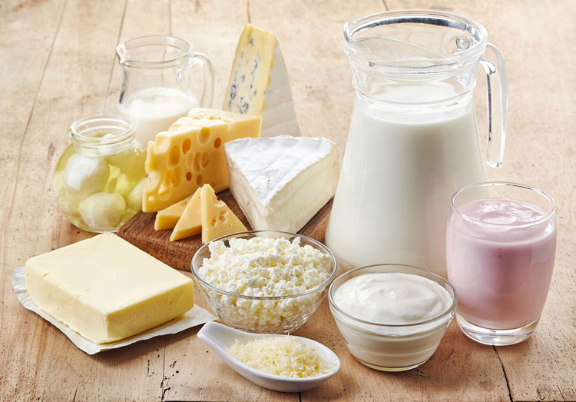
DAIRY MARKETS & PRODUCTS
Australia exports nearly half of the milk that it produces. This makes it the third largest exporter behind the EU and New Zealand.
Australia accounts for 10% of the global export market.
Australia’s major export destinations by value are Japan, Singapore, China, Indonesia and Malaysia. Australia’s proximity to Asia means it is likely that exports to these areas will increase into the future as these regions continue to develop.
The most popular dairy products that the Australian domestic market consume are drinking milk, cheese, butter and yoghurt.
Drinking milk is the most popular dairy product consumed in Australia; this is followed by cheese, yoghurt and butter.
Aust consumption Statistics per capita
Milk 102 litres
Cheese 13kg
Butter 4kg
Yoghurt 7kg

Slide 7
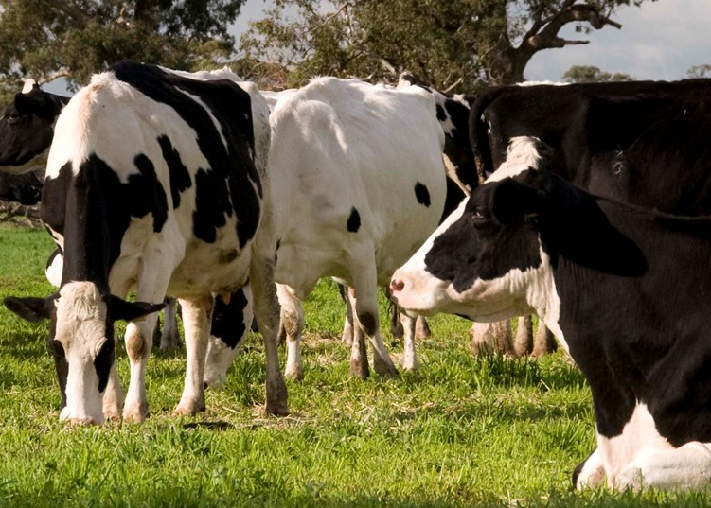
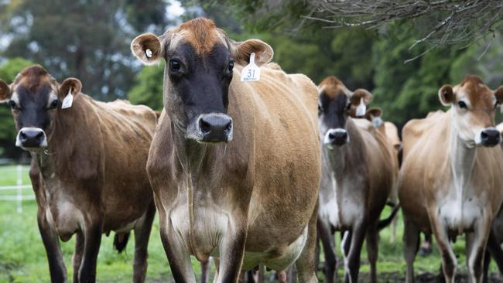
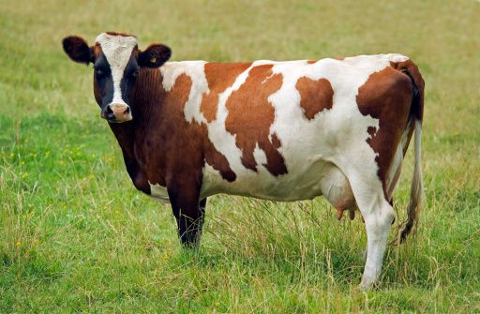
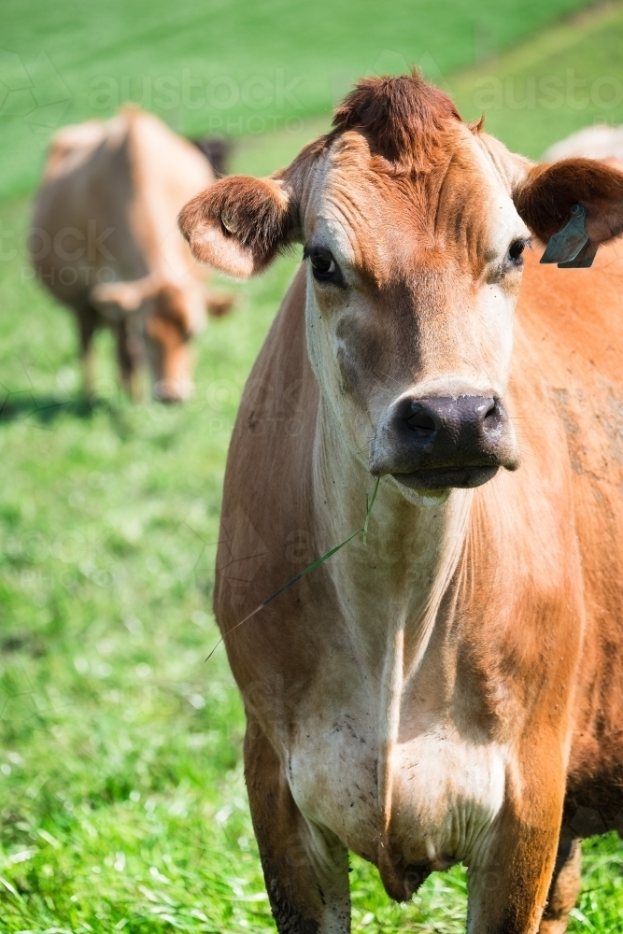
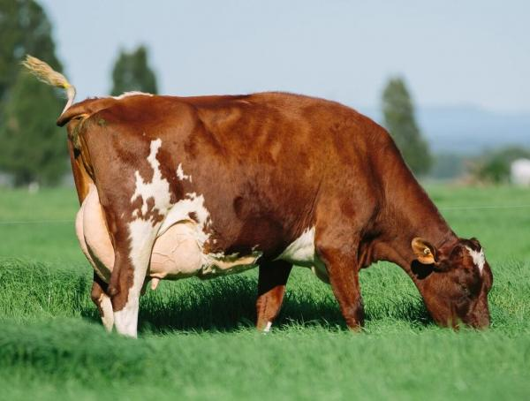
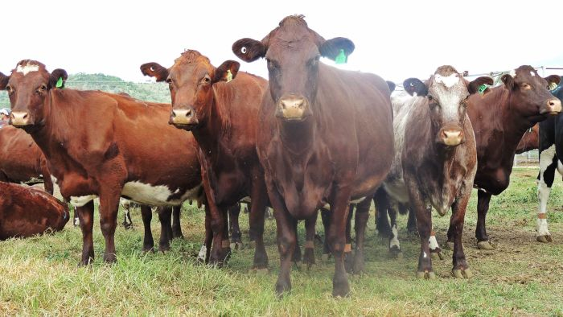
AUSTRALIAN DAIRY COW BREEDS
The dominant breed in Australia is the Holstein, accounting for around 70% of all dairy cattle.
Other important breeds include the Jersey, the Holstein/Jersey cross, Brown Swiss, Ayrshire and local breeds, the Australian Red and the Illawarra.
Holstein
Brown Swiss
Ayrshires
Jersey
Australian Red
Illawarra

Slide 8
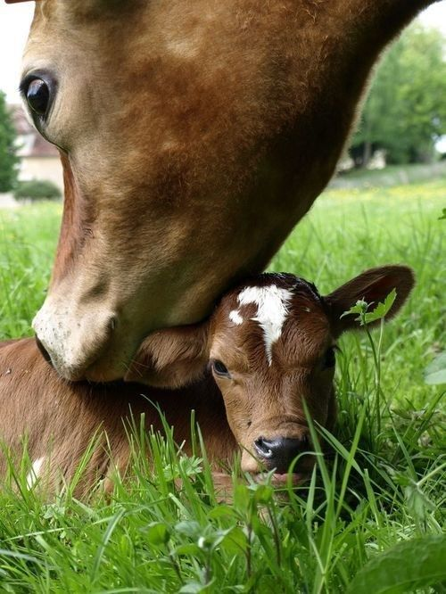
HEALTH CARE, PESTS & DISEASES
Animal health, welfare and biosecurity are all important stages of the milk production chain. If managed poorly each can have adverse impacts on productivity.
Biosecurity programs for the dairy industry are designed to prevent the spread of infectious disease and contain disease outbreaks when they occur.
Parasites and disease impact on all livestock production systems, including dairy cattle. Livestock affected by disease may not always show obvious clinical signs but there may still be negative impacts on growth rates, reproduction rates, carcase quality and milk production.
Some of the key cattle parasites include stomach worms, lice and ticks while diseases include grass tetany, pink eye, pregnancy toxaemia and vibriosis
Biosecurity is important at the national, regional and property level.
Producers are governed by Australian Animal Welfare Standards and Guidelines. State and territory governments are responsible for animal welfare laws and their enforcement. These are enforced through animal welfare or prevention of cruelty to animals’ legislation.

Slide 9
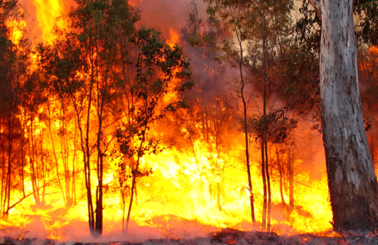
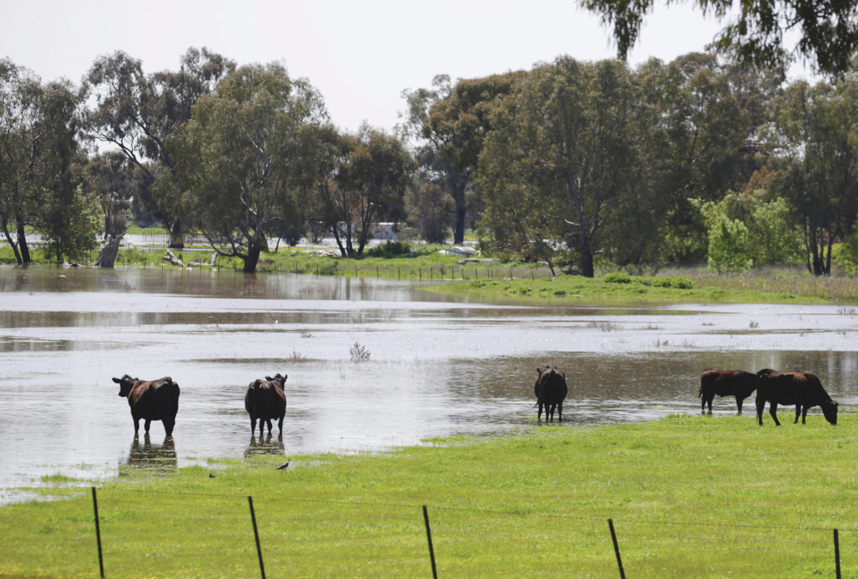
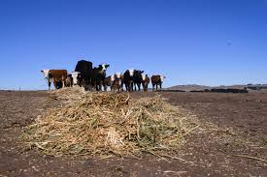
RISKS & CHALLENGES
Like any primary production enterprise there are risks associated with commercial production of Dairy cattle. Some will be outside of a producer’s control however experienced producers are usually able to manage these risks.
Risks include the loss of vital export markets. The COVID-19 outbreak had a massive impact on a lot of our export markets.
Disease and pests, it is extremely important that we maintain Australia’s freedom from major cattle diseases through strict quarantine laws and procedures.
Here in Australian weather events such as drought, fires and flooding take a huge toll on our farming communities. They really need our support.

Slide 10
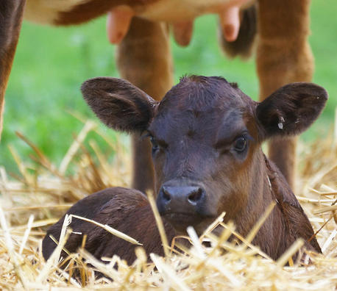
POP QUIZ
The dairy industry makes an important contribution to the Australian economy. It accounts for around ____% and $_________ of the gross value of agricultural production.
Australia is the world’s third largest dairy exporter TRUE/FALSE.
Name three products made from milk _______________, _________________, __________________.
The Australian dairy industry is concentrated in the _________________ regions of Australia.
Biosecurity programs for the dairy industry are designed to prevent____________ __________________________and contain disease outbreaks when they occur.
What are three challenges Australian farmers face ________________________, _______________________, ___________________________
What are the common Dairy cow breeds found in Australia ______________________________________________________________________________________________________________________________________________
How much milk to Australians consume per capita ____________________________
A male cow is a _______________ and a female cow is a ______________________
Pregnancy usually last for _______________ days.
The first cows arrived in Australian in _____________________

Slide 11
NOTES
________________________________________________________________________________________________________________________________________________________________________________________________________________________________________________________________________________________________________________________________________________________________________________________________________________________________________________________________________________________________________________________________________________________________________________________________________________________________________________________________________________________________________________________________________________________________________________________________________________________________________________________________________________________________________________________________________________________________________________________________________________________________________________________________________________________________

Slide 12
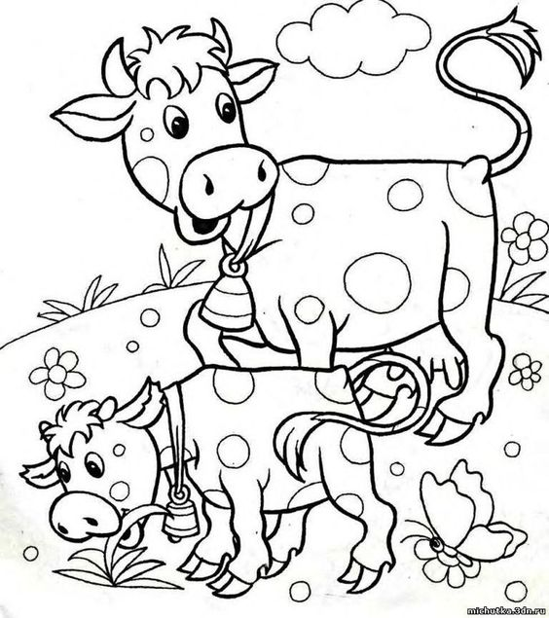
DAIRY CATTLE

Slide 13
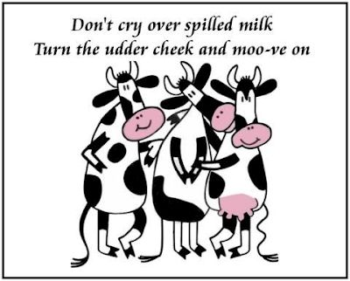
RESOURCE
www.agriculture.gov.au www.dairyaustralia.com.au

